Slide 1
DV1C04 Deployt & Monitoring in DevOps
L03
Manifest

Slide 2
Learning Objectives
Identify tools for Deploy Phase

Slide 3
Using ERB templates
A template is a text file. It can do computations, run Ruby code, and look up the values of variables in Puppet manifests.
You may use a template instead of a text file everywhere you would use Puppet to deploy a text file.
A template can be as simple as a static text file in the most basic scenario.
You may also use ERB (embedded Ruby) syntax to inject variables into it.

Slide 4
Using ERB templates
Example
<%= name %> is my best friend.
If Nicholas is present in the variable $name, the template will evaluate as follows:
Nicholas is my best friend.

Slide 5
Using ERB templates
Example
<%= name %> is my best friend.
If Nicholas is present in the variable $name, the template will evaluate as follows:
Nicholas is my best friend.

Slide 6
Using ERB templates
This simple approach may be used to generate a large number of files that only differ in the values of one or two variables, such as
virtual hosts
inject values into a script, such as database names and passwords.

Slide 7
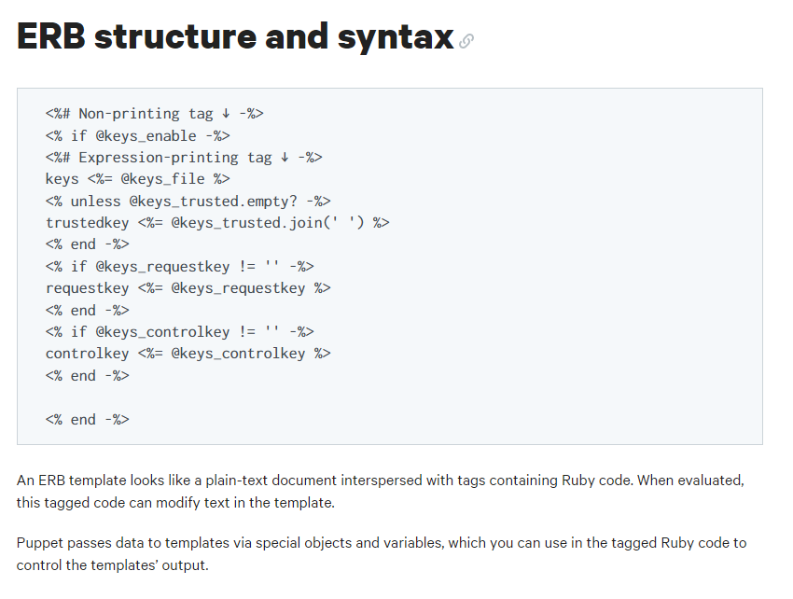
ERB structure and syntax
Source: https://puppet.com/docs/puppet/5.5/lang_template_erb.html

Slide 8
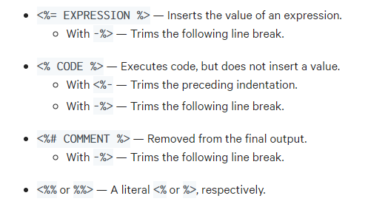
ERB Tags
Source: https://puppet.com/docs/puppet/5.5/lang_template_erb.html

Slide 9
Using EPP templates
EPP templates are the successors to ERB templates, which will be phased out in a future Puppet version.
EPP templates are written in Puppet and are not compiled with Ruby.
EPP templates can now be called using two new functions: epp and inline epp.

Slide 10
Using EPP templates
The EPP equivalents of the ERB template and inline template functions are these two functions. Variables are addressed using the Puppet notation, $variable, rather than @variable, as they are in EPP templates.
In EPP templates, all variables are completely scoped; unlike ERB templates, there is no need to utilize the scope function.

Slide 11
Using EPP templates
EPP templates are invoked using the epp and inline epp functions.
EPP templates allow you to use Puppet syntax within a template, making it easier to create a configuration file that includes Puppet variables.

Slide 12
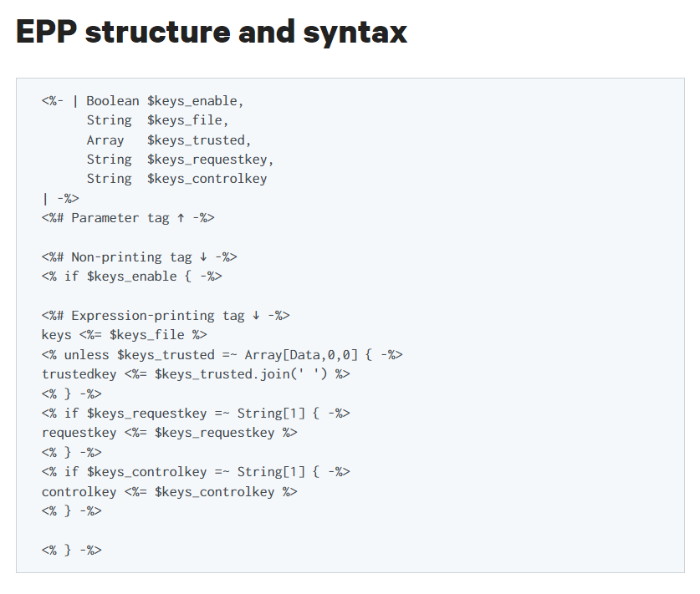
Using EPP templates
Source: https://puppet.com/docs/puppet/5.5/lang_template_epp.html

Slide 13
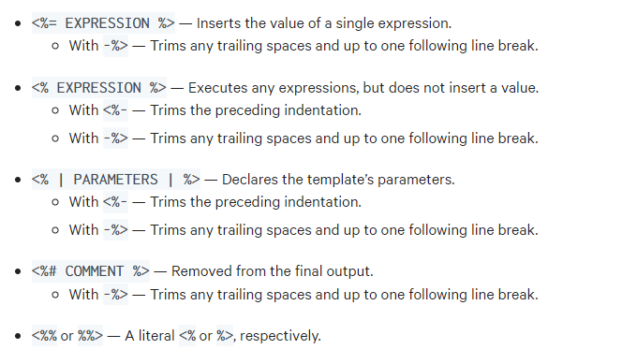
EPP Tags
Two tags for Puppet code, optional tags for parameters and comments, and a means to escape tag delimiters are all available in PP.
Source: https://puppet.com/docs/puppet/5.5/lang_template_epp.html

Slide 14
Manifest
Puppet language file is called Manifest.
Puppet begins constructing a catalog with either a single manifest file or a directory of manifest files that are interpreted as if they were a single file.
The primary manifest, often known as the site manifest, is the beginning point.

Slide 15
Manifest
Puppet is built in such a way that all of the Puppet codes begin with the .pp extensions must be stored in the Manifest directory.
It can be a single file or multiple files inside a manifest directory.

Slide 16
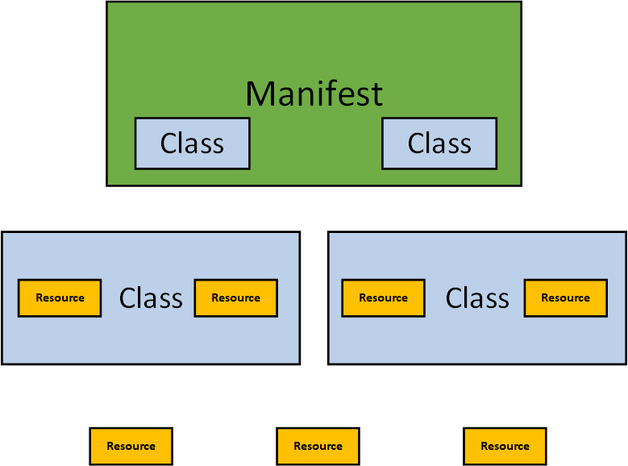
Manifest

Slide 17
Manifest
puppet config print command shows the default path of manifests directory which is also referred as main manifest.
/etc/puppetlabs/code/environments/production/manifests
Note: This command can be also used to find all of the puppet config parameters as well
Whenever a puppet agent gets connected to the master, the master looks at the main manifest to compile the catalogs to be shared to the agent.

Slide 18
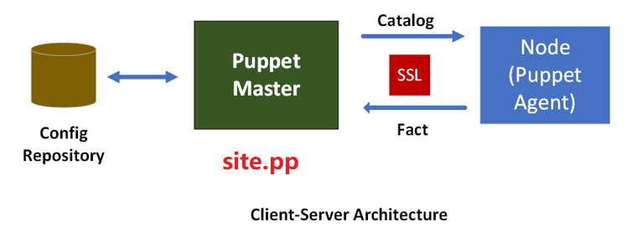
site.pp
It is the entry point of the entire Puppet network for catalogs compilation.
It is also referred as site manifest.

Slide 19
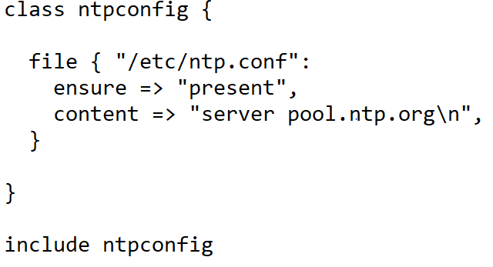
Manifest File
You will declare multiple classes inside site.pp using the keyword 'include’.
A simple manifest file is similar to the class file except Puppet will automatically load and compile the puppet codes without providing different directory location.
in real production environment, avoid writing puppet codes here, use this file to declare classes only.

Slide 20
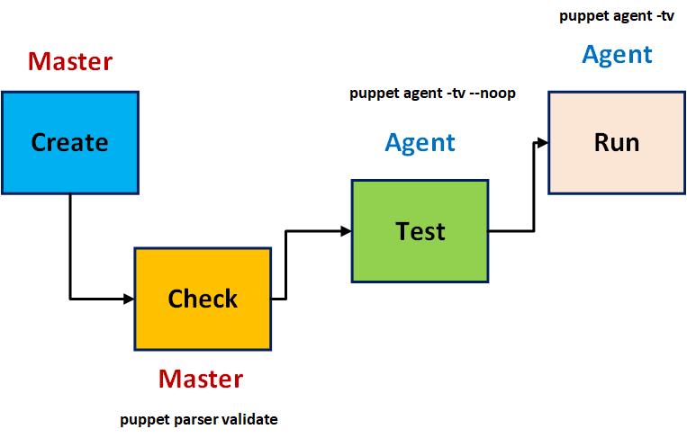
Code Creation Process

Slide 21
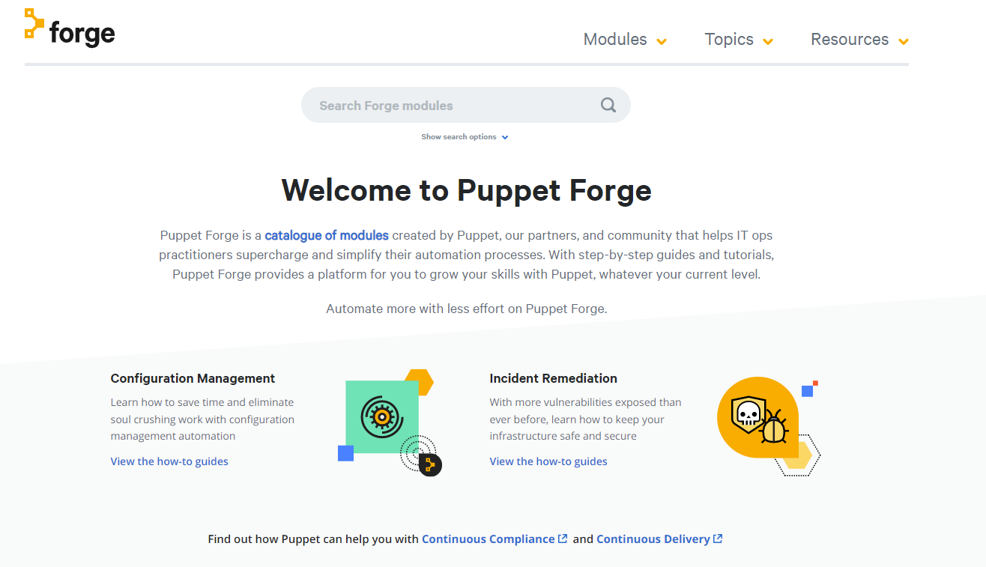
Puppet Forge
Puppet Forge is a collection of modules built by Puppet, our partners, and the Puppet community to enable IT operations professionals speed up and simplify their automation processes.
https://forge.puppet.com/

Slide 22
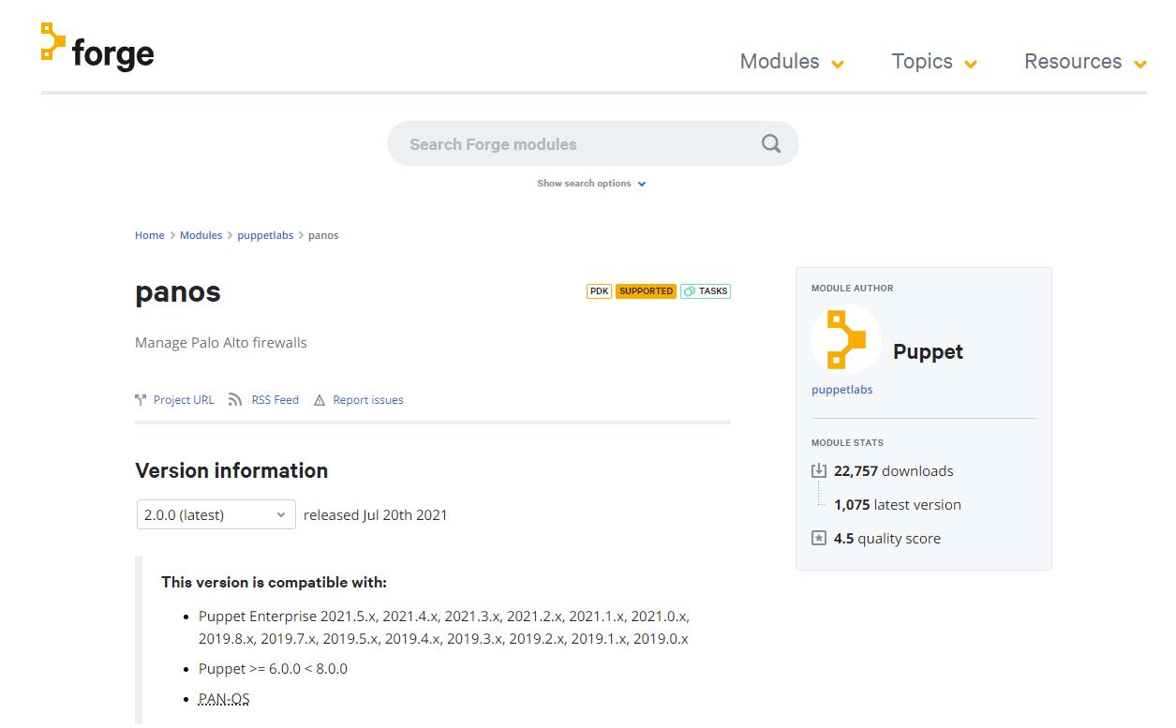
Puppet Forge
PANOS is a module developed by Puppet that configures Palo Alto firewalls.

Slide 23
References
https://puppet.com/docs/puppet/7/dirs_manifest.html
Puppet for Absolute Beginners - Hands-on by Mumshad Mannambeth, Yogesh Raheja
Puppet Cookbook - Third Edition By Thomas Uphill, John Arundel
Puppet 6 Essentials By Andrew Mallett

Slide 24
Thank you

